Slide 1


Shell-Edunet Skills4Future
Internship Project
Notes:
1

Slide 2

Student Name : Rugved Bharat Gaikwad
Student ID : STU6746c714250771732691732
College Name : Ajeenkya DY Patil School of Engineering, Pune
Notes:
2

Slide 3
CAPSTONE PROJECT SHOWCASE
Project Title : Healthcare Prediction: Analyzing Diabetes Risk through Data Insights and Machine Learning
Abstract | Problem Statement | Project Overview | Proposed Solution | Technology Used | Modelling & Results | Conclusion | Q&A

Slide 4
Abstract
This project focuses on analyzing healthcare data to predict the risk of diabetes among patients using various machine learning techniques and data visualizations. By examining key factors such as age, BMI, glucose levels, and insulin, we identify patterns that influence diabetes risk. The dataset was processed and visualized to highlight correlations and trends. Key analysis techniques, including KMeans clustering, scatter plots, and feature importance from a random forest model, were applied to extract valuable insights. Additionally, a focus on BMI categories and their relation to diabetes outcomes provides a deeper understanding of patient demographics. This work demonstrates the power of data science in healthcare, offering actionable insights for early diabetes detection and prevention strategies.

Slide 5
Problem Statement
Diabetes has become one of the most prevalent chronic diseases worldwide, leading to severe health complications if not diagnosed and managed early. Predicting the risk of diabetes in patients based on factors such as age, body mass index (BMI), glucose levels, and insulin sensitivity can significantly improve early detection and prevention efforts. The challenge is to build a predictive model that can identify individuals at high risk of developing diabetes using available healthcare data. This project aims to analyze and visualize the relationships between various health indicators and diabetes outcomes, applying machine learning techniques to predict and classify patients based on their likelihood of developing diabetes.

Slide 6
Project Overview
This project aims to predict the risk of diabetes using healthcare data, focusing on features like age, BMI, glucose, and insulin levels. The process involves data preprocessing, exploratory data analysis (EDA), and the application of machine learning techniques such as KMeans clustering and Random Forest classification. Key visualizations, including scatter plots and pie charts, are used to understand the relationships between variables and predict diabetes outcomes. The goal is to provide insights that can assist in early detection and preventive measures for diabetes.

Slide 7
Proposed Solution
The solution involves preparing the data, visualizing key feature relationships, and using KMeans clustering to identify patient groups. A Random Forest model will classify patients based on diabetes risk, with feature importance highlighting the most influential factors. Visualizations will then help present the findings and insights for early diabetes detection and prevention.
Data Preprocessing: Clean and prepare the dataset for analysis.
Exploratory Data Analysis (EDA): Visualize relationships between key features like age, BMI, and glucose.
KMeans Clustering: Group patients with similar characteristics.
Predictive Modeling: Use Random Forest to classify patients as diabetic or non-diabetic.
Feature Importance: Identify key factors influencing diabetes risk.
Visualization: Present insights through charts and graphs.

Slide 8
Technology Used
Python: Programming language for data analysis and machine learning.
Pandas: Library for data manipulation and preprocessing.
Matplotlib & Seaborn: Libraries for data visualization.
Scikit-learn: Machine learning library for model building and clustering (KMeans, Random Forest).
Jupyter Notebook / Google Colab: Development environment for interactive coding and analysis.

Slide 9
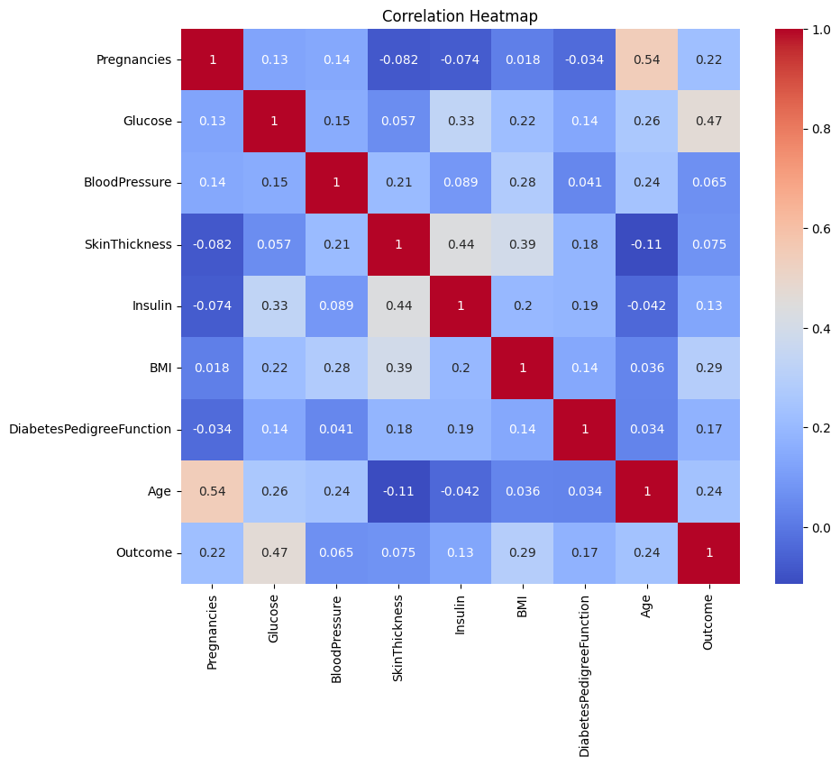
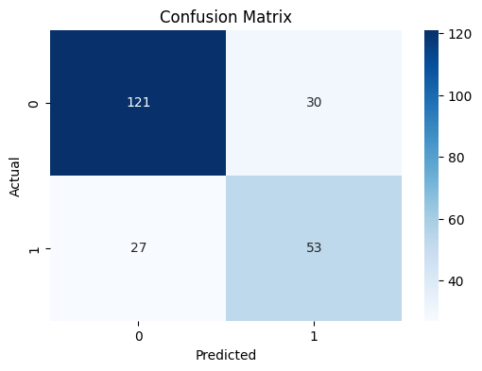
Modelling & Results

Slide 10
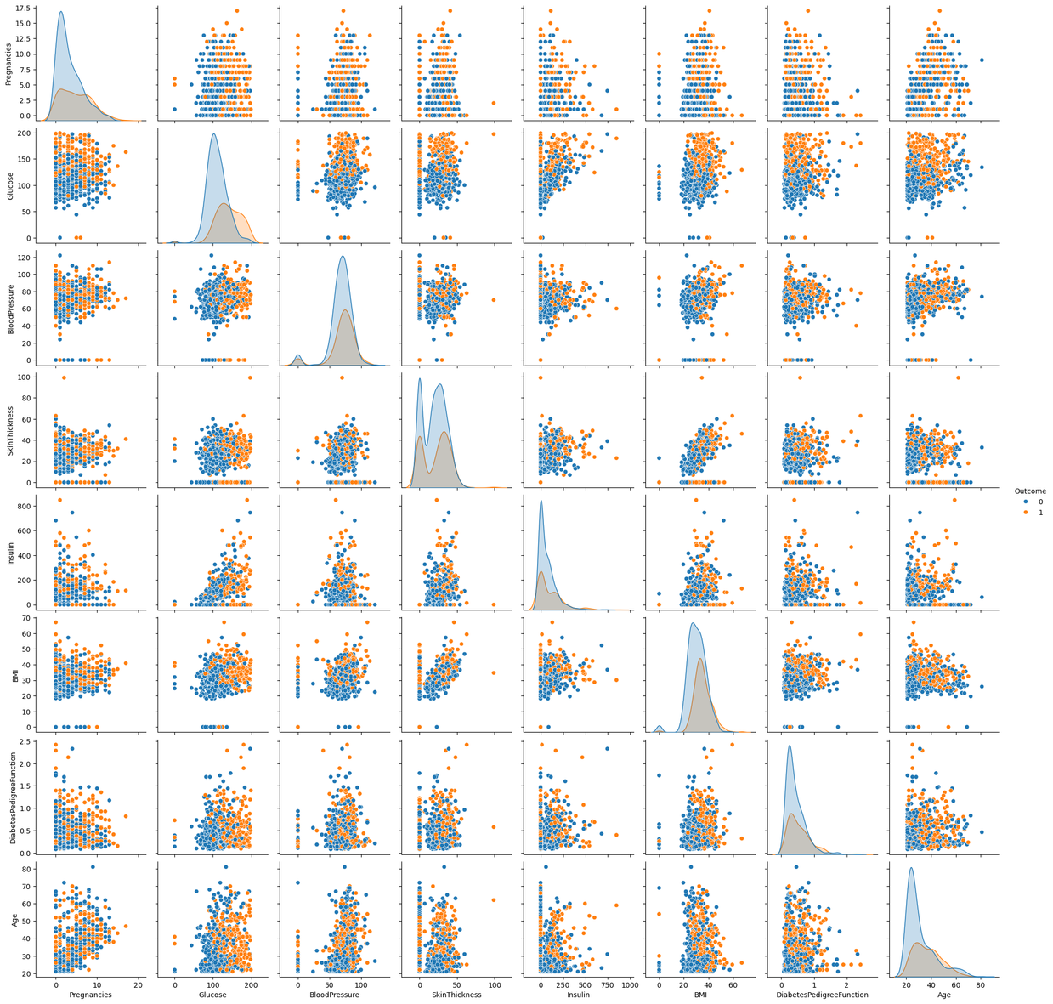
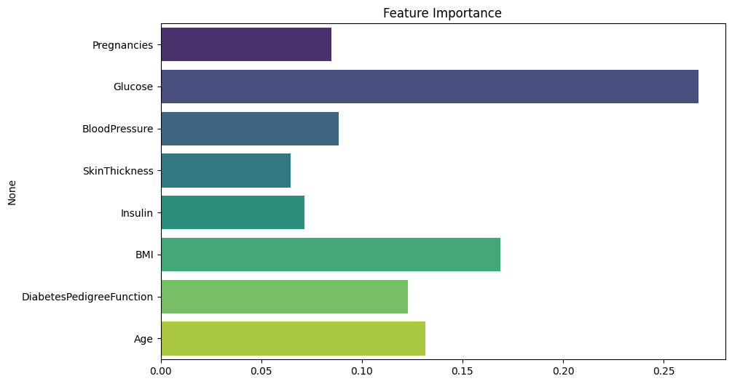

Slide 11
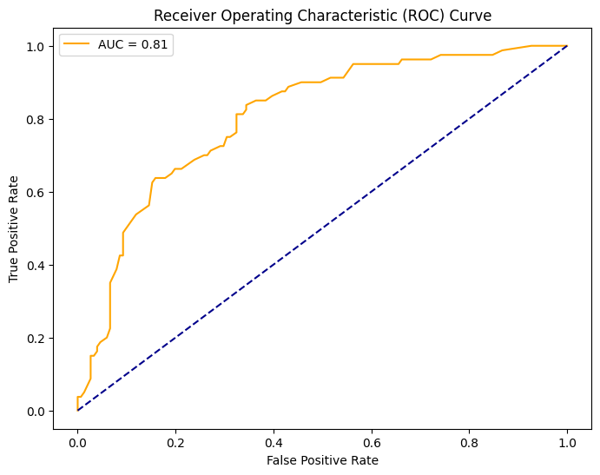
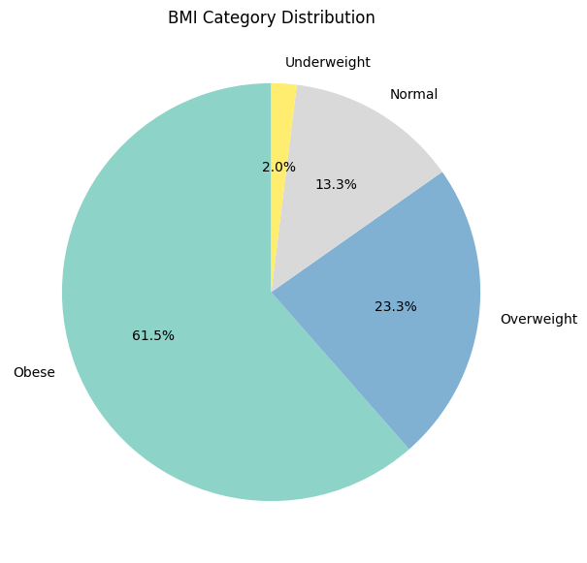

Slide 12
Conclusion
The project successfully identified critical factors such as BMI, age, and glucose levels that influence the risk of diabetes. The KMeans clustering technique revealed patient subgroups that could be targeted for preventive interventions. The Random Forest classifier demonstrated good performance in predicting diabetes outcomes, with BMI and age emerging as the most significant predictors. The visualizations helped in interpreting the data and understanding the relationships between features. Overall, the findings offer valuable insights for early diabetes detection and prevention strategies in healthcare.
Find the project code here :
https://github.com/Rugved1204/Diabetes-Healthcare-Prediction

Slide 13
Thank You!
Notes:
Thank You !!

